Slide 1
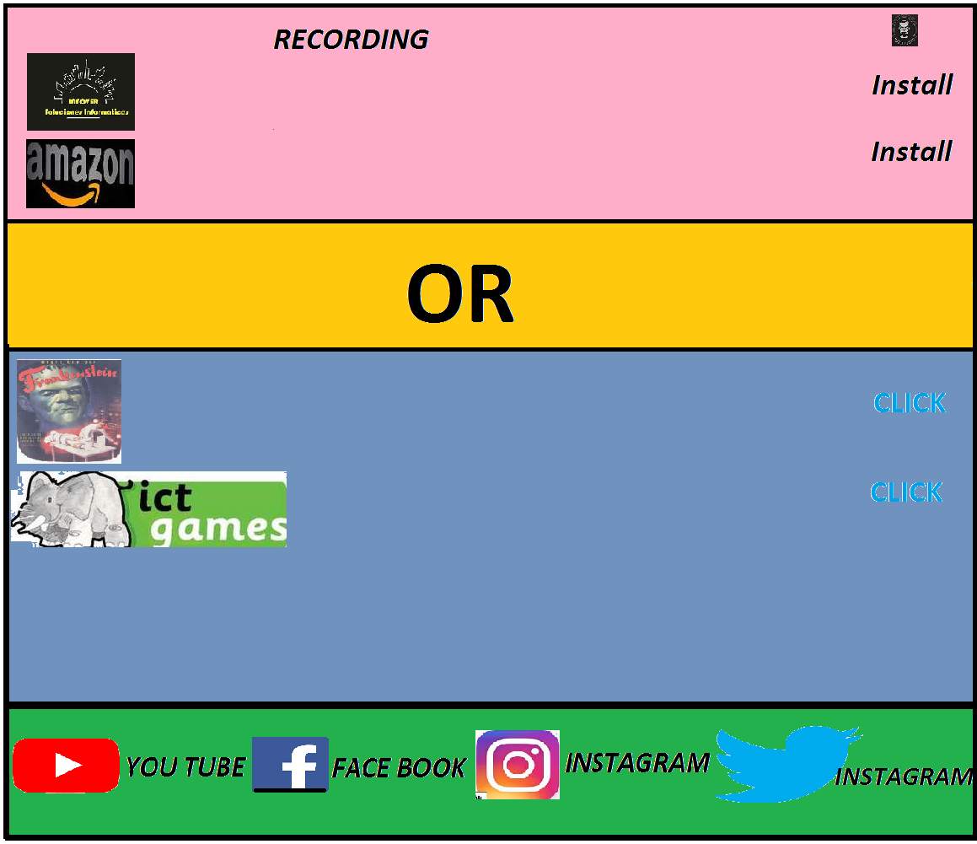
CHALLENGE

Slide 2
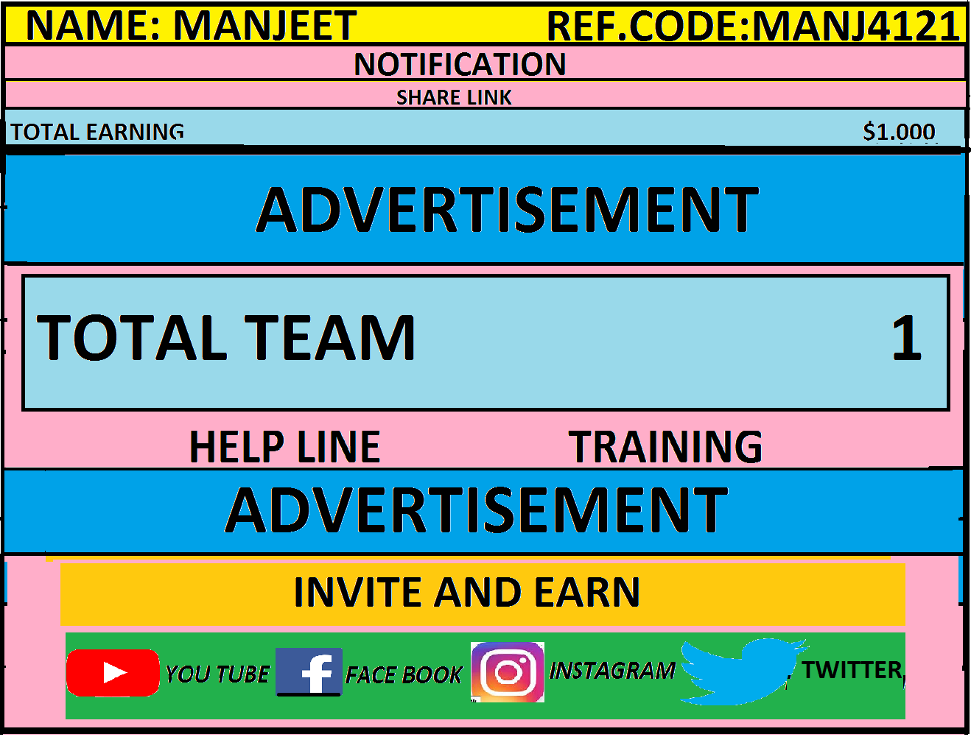
DASHBOARD

Slide 3
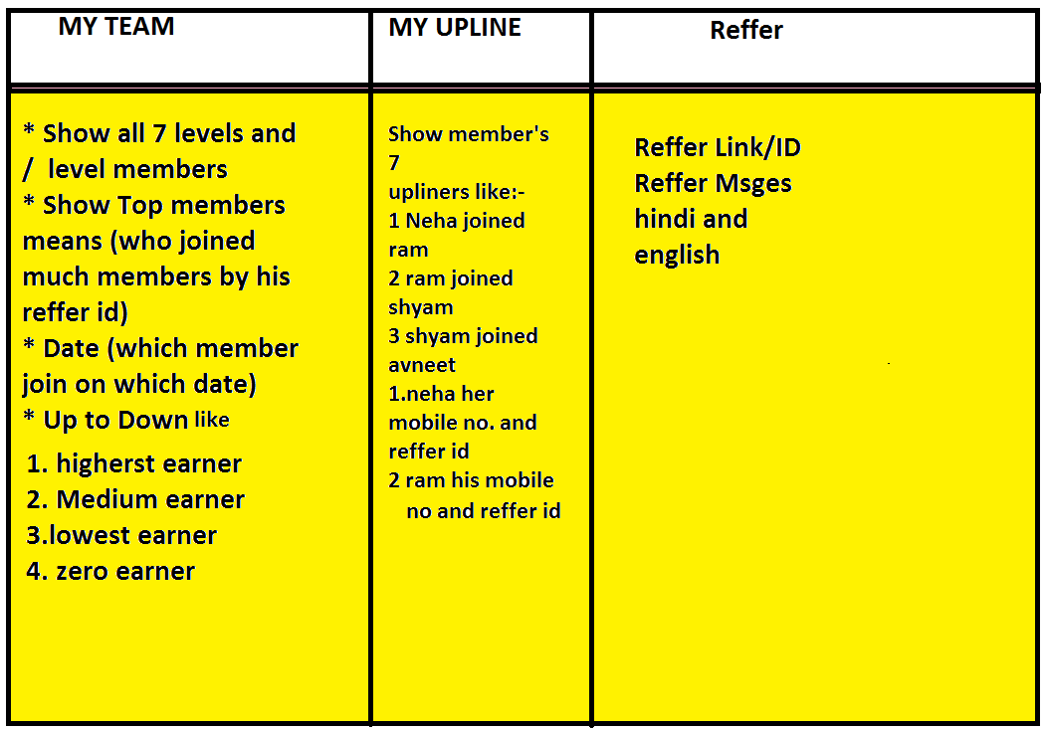
Network

Slide 4
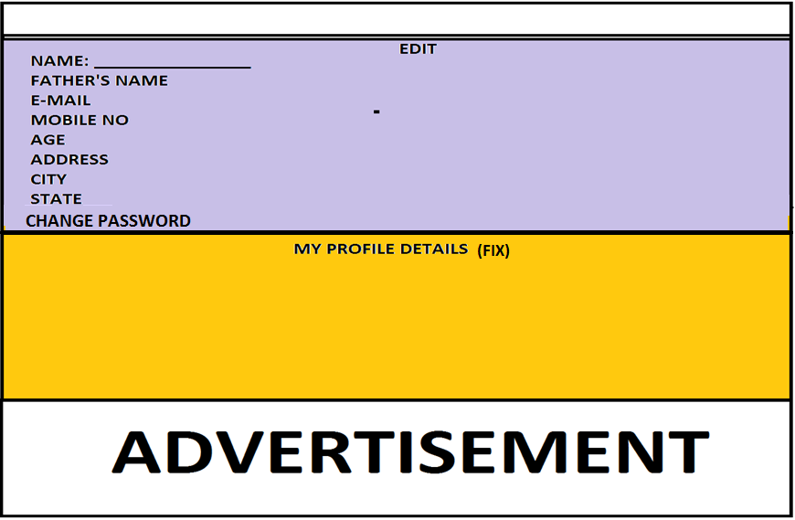
MY PROFILE

Slide 5
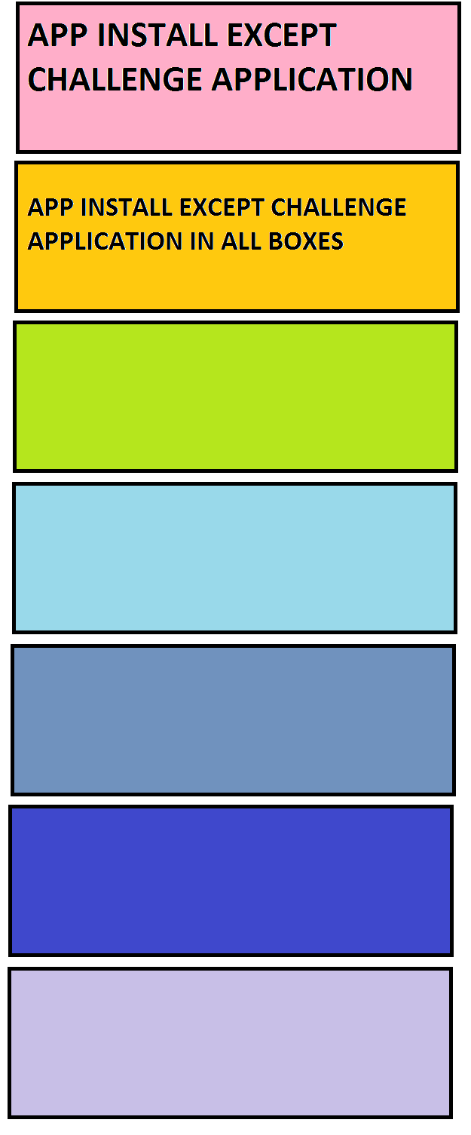
EARN MORE

Slide 6

LEGAL

Slide 7
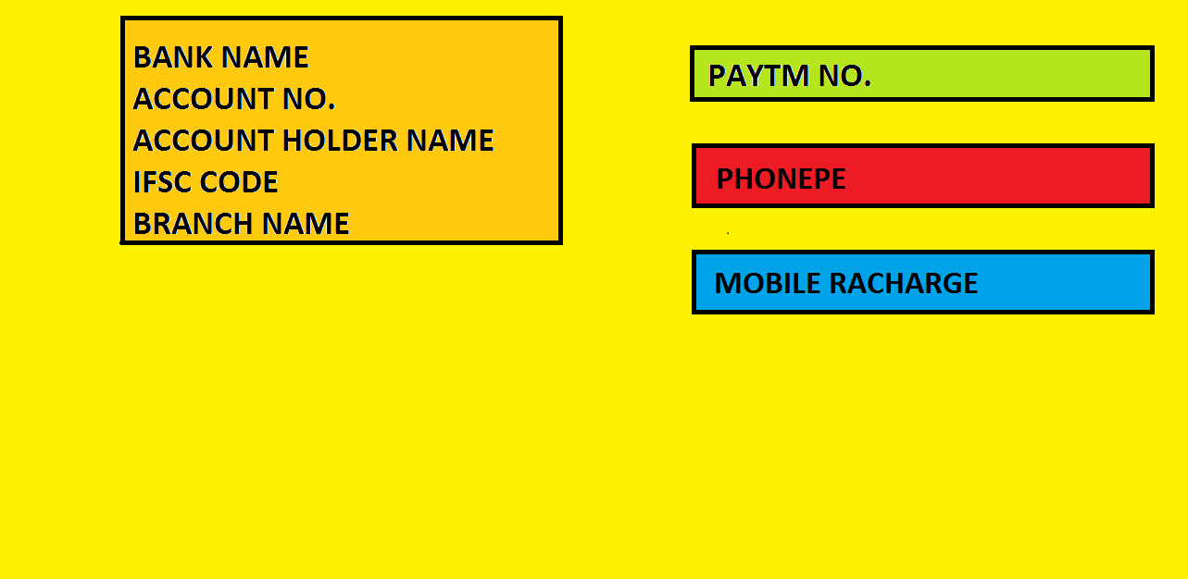

REDEEM

Slide 8
BUSINESS PLAN

Slide 9
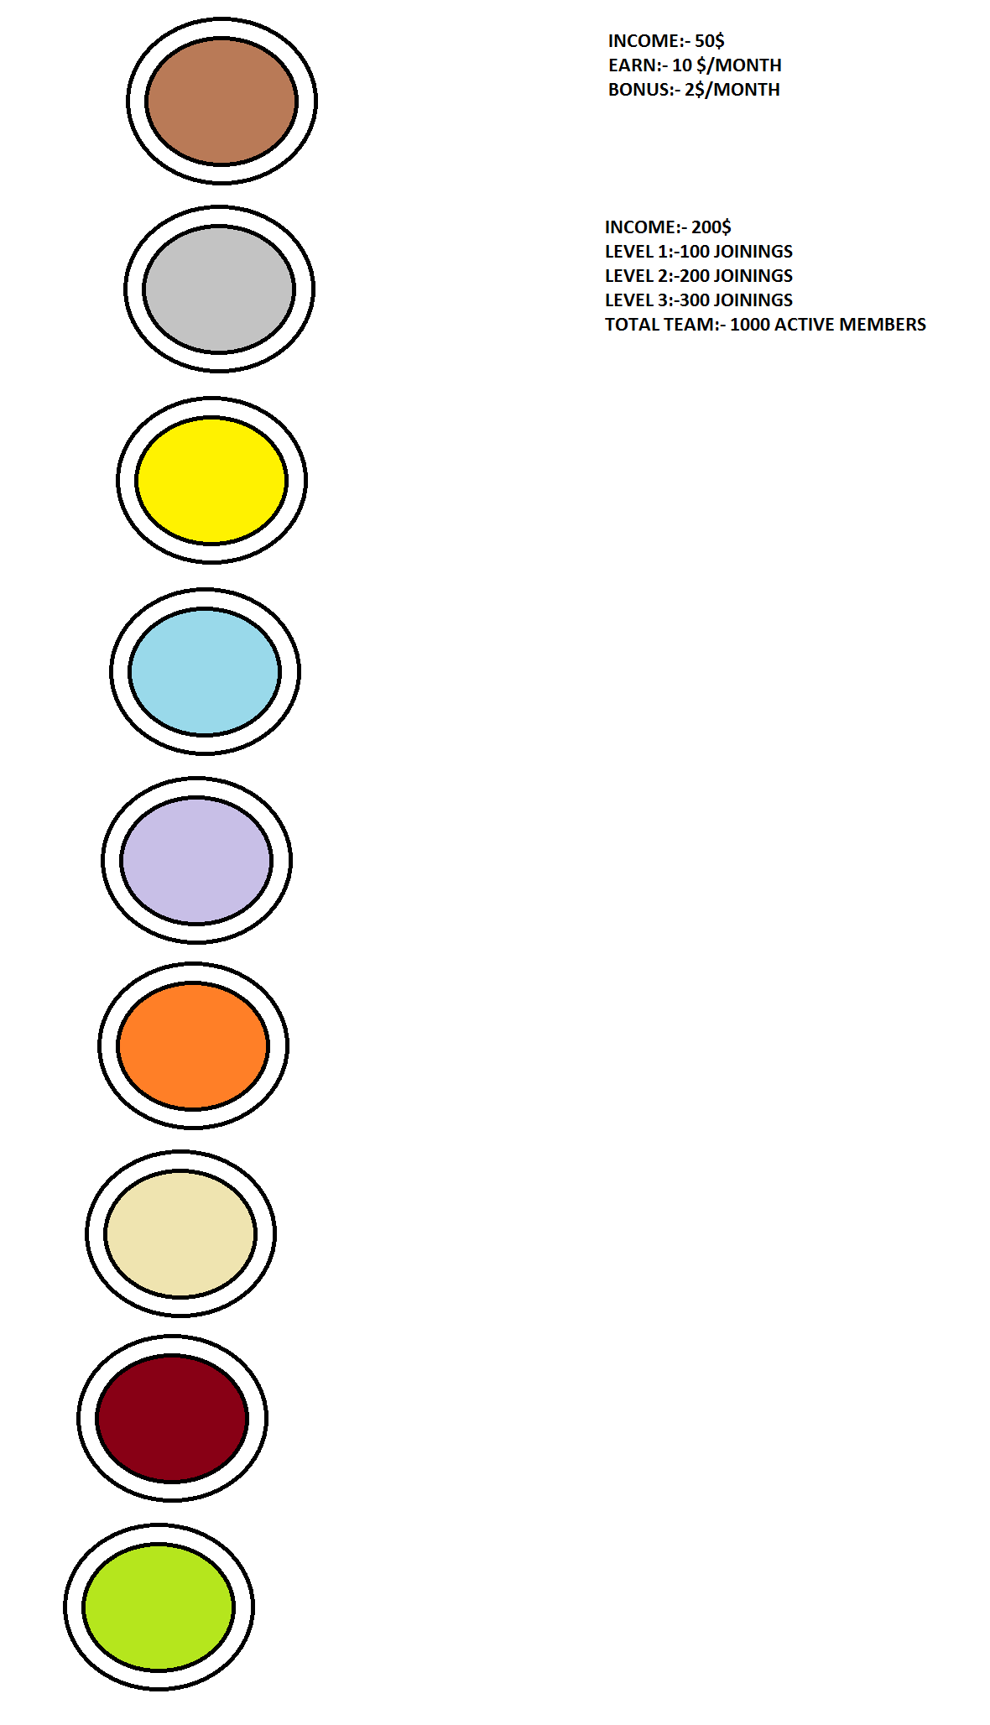
ACHIEVERS

Slide 10

SERVAY AND EARN

Slide 11
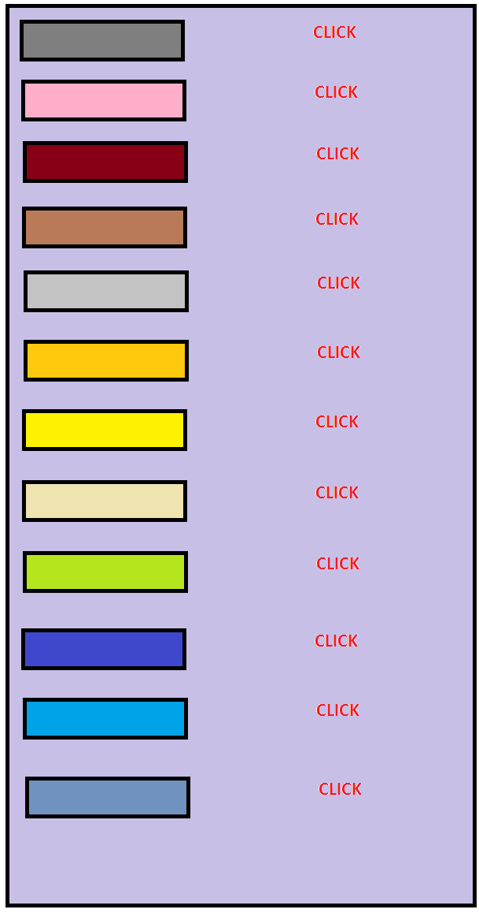
DAILY TASK

Slide 12
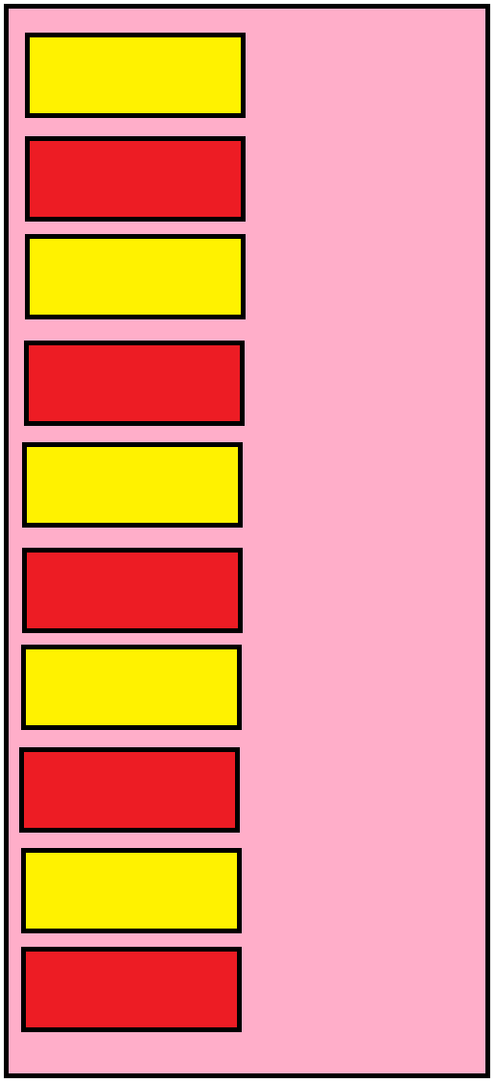
OFFER WALL

Slide 13

ADVERTISEMENT

Slide 14
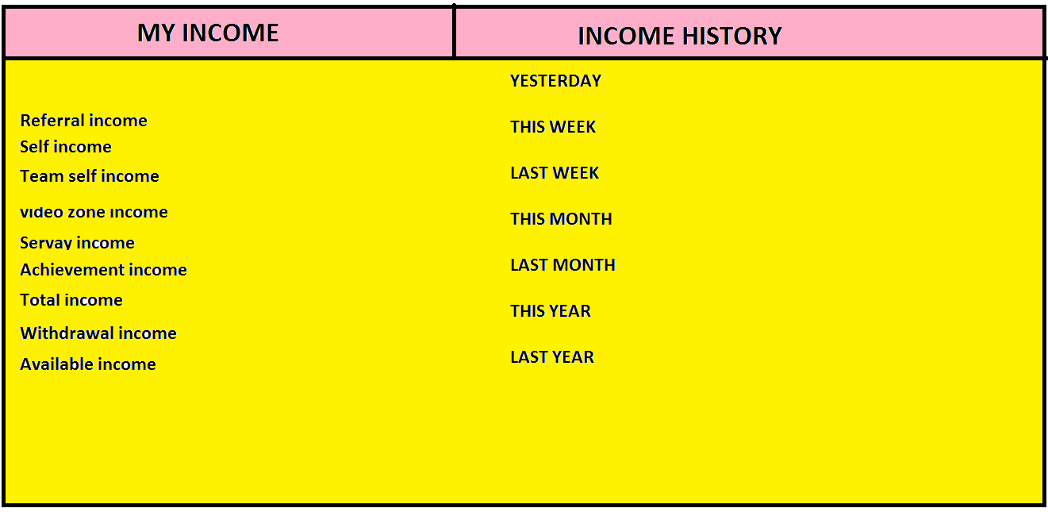
MY INCOME

Slide 15
FALSE INCOME
ON THIS PAGE, I WILL MAKE HERE SOME ID AND IN THIS ID I CAN MAKE MUCH MEMBERS AND INCOME WITHOUT REFFER TO ANYONE. IT’S ONLY FOR ADMIN.

Slide 16
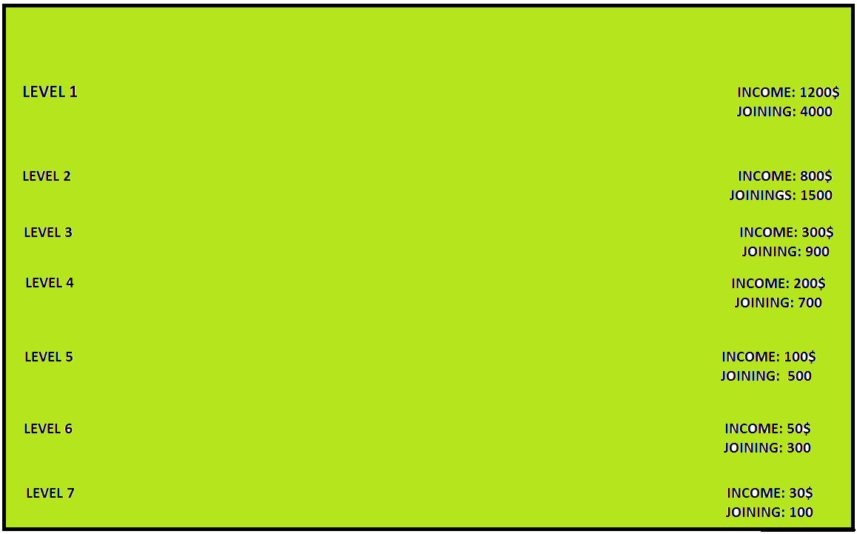
MY LEVELS

Slide 17
1. CHALLENGE
2.DASHBOARD
3.NETWORK
4.MY PROFILE
5.EARN MORE
6.LEGAL
7.REDEEM
8.PLAN
9.ACHIEVERS
10.SERVAY AND EARN
11.DAILY TASK
12.OFFER WALL
13.ADVERTISEMENT
14.MY INCOME
15.FALSE INCOME
16.MY LEVELS
17.PROMOTION
18.INVITE AND EARN
19.HOT LIST
20. NOTIFICATION
21. PLAY GAME

Slide 18
PROMOTION
THERE WILL BE ADD SOME BANNERS IMAGES FOR UPLOAD IN APPLICATION AND APPLY DOWNLOAD BUTTON IN APPLICATION FOR DOWNLOAD

Slide 19
INVITE AND EARN
THERE WILL BE SOME MASSAGES FOR INVITE PEOPLE

Slide 20

HOT LIST
THERE WILL BE ADD SOME POPULAR MEMBER’S NAME,EARNING AND JOININGS AND REFFER ID.

Slide 21
NOTIFICATION
I WILL NOTIFY TO ALL MEMBERS FOR OFFERS ON FESTIVALS OR ANYTHING ELSE

Slide 22

PLAY GAME
THERE WILL BE SOME GAMES FOR PLAY AND EARN.

Slide 23
ID Block/Unblock
Admin should have power to block/unblock member’s ID.

Slide 24
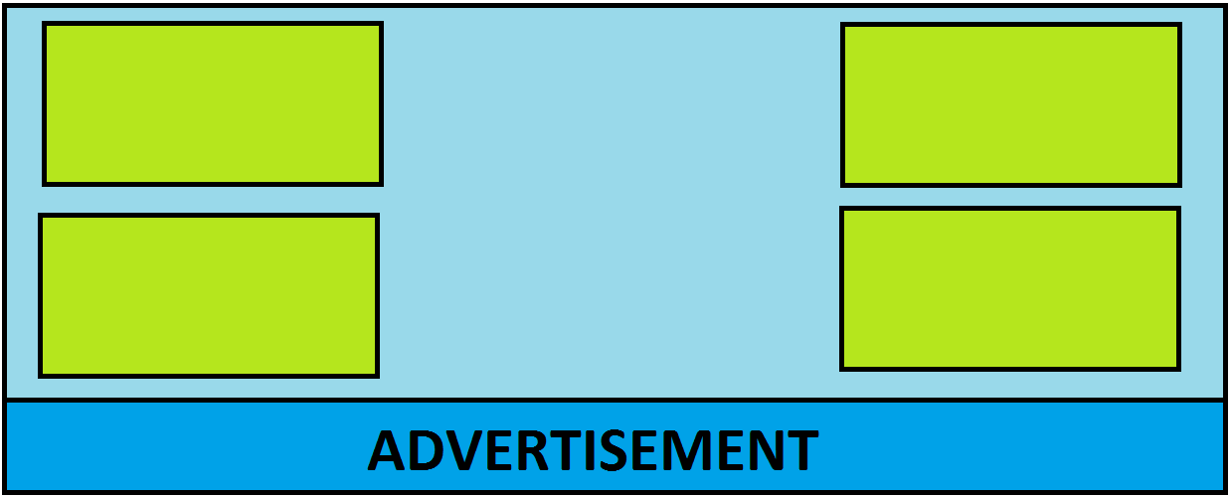
VIDEO WALL

